Slide 1
Chapter 2: Business Intelligence Capabilities

Slide 2
Outline
Four key capabilities of BI solutions
  Organizational Memory Capability
  Information Integration
  Insight Creation
  Presentation
We will discuss
  Each capability
  Factors necessitating each capability
  Technologies enabling each capability

Slide 3
Organizational Memory Capability
The ability to
store
information
and
knowledge

Slide 4
Information Integration Capability
The ability to
link
structured and
unstructured
data
from
a variety of sources

Slide 5
Insight Creation Capability
The ability to
develop
new insights
and
use them in
the short-term or long-term
to make better decisions

Slide 6
Presentation Capability
The ability to
use
appropriate reporting and
balanced scorecards tools,
and thereby
make BI more valuable to users

Slide 7
Four Synergistic Business Intelligence Capabilities
Users
Information presented in user-friendly fashion and in ways most appropriate for each user
Presentation
New insights and information to support decision making in a real-time fashion
Insight Creation
Synthesized information about the past and present (structured and unstructured, external and internal)
Information Integration
Historical information and explicit knowledge accumulated over time (mainly structured and internal)
Organizational Memory
© Sabhewal & Becerra-Fernandez

Slide 8
Three Categories of Features
BI capabilities support features of BI solutions which are classified into 3 broad categories related to capabilities
Benchmarking
    Relative to competition and industry trends
Intelligence
    Ability to search and utilize data across disparate sources
Convenience
    Customization and connectivity

Slide 9
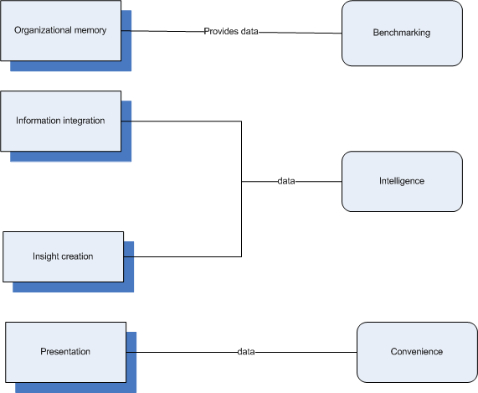
Relation of Categories to Capabilities

Slide 10
Why Information Integration Capability?
Mutually disconnected, incompatible transactional systems exist within an organization
Data exists outside of transactional systems such as e-mail, audio and video files, etc.
A lot of relevant external data is available, such as web sites, industry reports, expert opinions
More complex decision making due to an increase in the diversity of factors to consider

Slide 11
Information Integration Capability
External information and knowledge from environmental scanning and web mining
External
Unstructured information and knowledge from text mining, web mining and digital content management systems
Source of Content
Both past content as well as emergent, real-time content needs to be integrated in each situation
Internal
Structured
Unstructured
Nature of Content
Structured information and explicit knowledge from ERP systems, transactional systems, and knowledge repositories
© Sabhewal & Becerra-Fernandez

Slide 12
Why Insight Creation Capability?
Need quick reflexes
  Decisions must be made quickly to be competitive
Domain complexity is increasing
  Must consider information from diverse arenas

Slide 13
Insight Creation Capability
Insight creation or Learning
Impacts of Insight Creation Capability
Real-time Decision Making
Describe What Happened
Understand What Happened
Predict What Will Happen
Outputs of Insight Creation Capability
Note: The relative sizes of the boxes in the above cells represent the relative magnitudes of impacts of insight creation capability on real-time decision making and insight creation or learning.
© Sabhewal & Becerra-Fernandez

Slide 14
Why Presentation Capability?
Content and format needs differ
  Role
    Ex. Top executive interest in firm-level performance vs. customer-support personnel interest in aids that support real-time responses to customers
  Task
    Ex. Customer-support specialist uses different information for each task
  Preference
    Ex. Individuals differ: Big picture view vs details first

Slide 15
Factors Affecting Presentation
Role
Content
Task
Format
Presentation
Preference
© Sabhewal & Becerra-Fernandez

Slide 16
Presentation Capability Technologies
Goal: Maximize learning and decision making
Online Analytical Processing (OLAP)
  Explore and analyze interactively
Visualization
  A picture is worth a thousand words
Digital Dashboards
  Display metrics in customizable interface and navigable layout
Scorecards
  Monitor and show performance

Slide 17
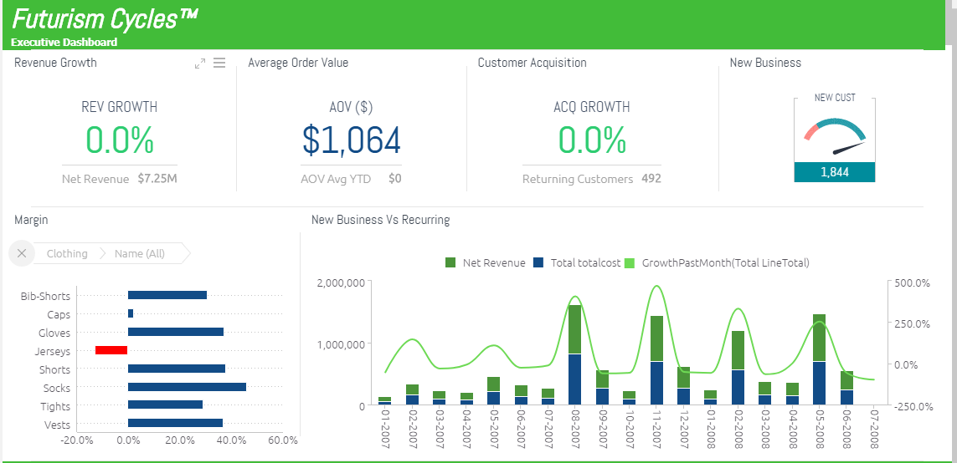
Dashboard

Slide 18
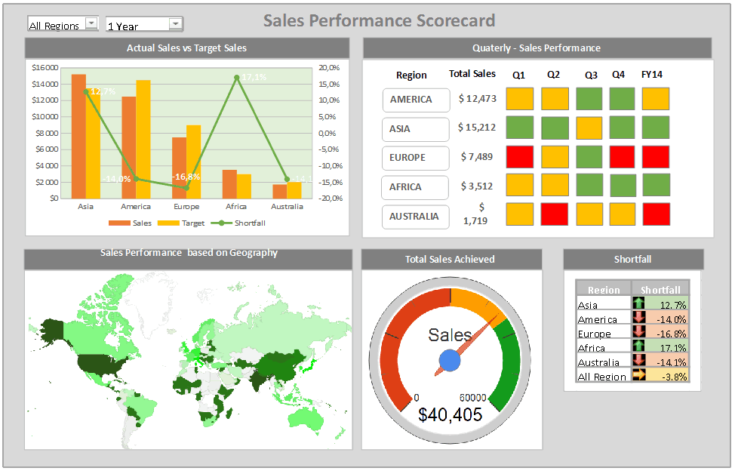
Scorecard

Slide 19
Inputs and Outputs of the Four Business Intelligence Capabilities
Users
Information presented in user-friendly fashion and in ways most appropriate for the specific role, task, and situation
Presentation
Roles, tasks, and users’ inputs regarding preferred nature of presentation
New insights and information to support learning and real-time decision making
Insight Creation
Users’ inputs about the analyses that may be appropriate
Synthesized information about the past and present (structured and unstructured, external and internal)
Information Integration
Real-time data,
Unstructured Information, External Information
Historical information and explicit knowledge accumulated over time (mainly structured and internal)
Organizational Memory
Data, information, explicit knowledge (mainly internal, structured) stored in systems as events occur
© Sabhewal & Becerra-Fernandez

Slide 20
Technologies Enabling Business Intelligence Capabilities
Presentation
OLAP
Visualization
Digital Dashboards
Scorecards
Business Performance Management
Creation of Insights
Data Mining
Business Analytics
Real-time Decision Support
Information Integration
Environmental Scanning
Text Mining
Web Mining
Radio Frequency Identification Devices
Organizational Memory
Data Warehousing
Enterprise Resource Planning
Knowledge Repositories
Digital Content Management Systems
Document Management Systems
© Sabhewal & Becerra-Fernandez

Slide 21
Recap
We have:
Summarized the four main capabilities of BI solutions
Discussed each capability and the factors necessitating it
Examined the interrelationships among these four capabilities
Identified and discussed the technologies facilitating each capability

Slide 22
Key Terms
business analytics
business performance management
content
data
data mining
data warehousing
digital content management systems
digital dashboards
document management systems
enterprise resource planning systems
environmental scanning
information
information integration capability
insight creation capability
knowledge
knowledge repositories
learning
OLAP (online analytical processing)
organizational memory capability
presentation capability
radio frequency identification devices
real-time decision support
scorecards
text mining
transactional systems
virtualization
web mining
© Sabherwal & Becerra-Fernandez

